Slide 2
1MORE INC.
Hear & Now
1MORE is a consumer electronics company that focuses on acoustic technology research, headphones, smart hardware, and firmware device design. Official website: www.1more.com
1MORE＝Always surpass ourselves
Culture
Respond to the nature and human being
Advantages
Innovations to market
High efficiency in operation
Long term accumulation of core technologies
Mission
Perfect combination and consistent innovation of acoustics and aesthetics
Vision
Most recommended headphone

Slide 3
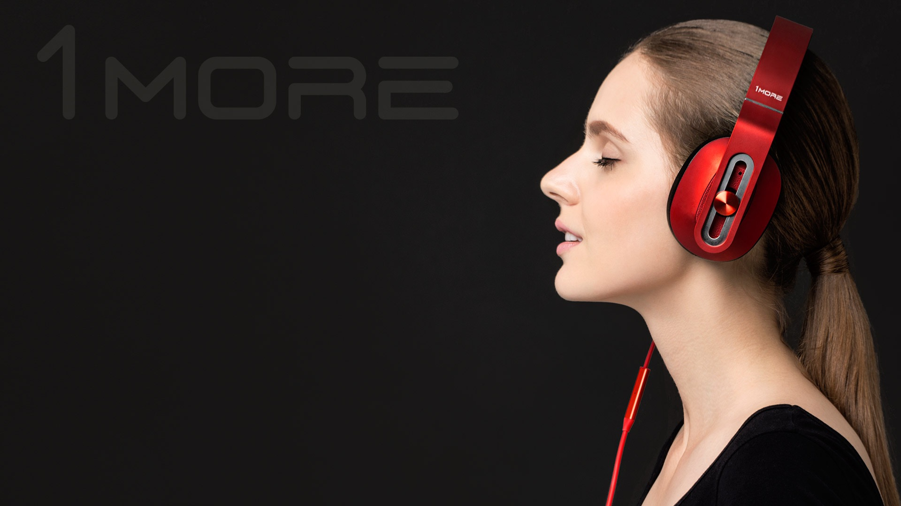
Hear & Now
1MORE is devoted to bringing music to life. We believe music is the monologue of the soul. Through modern excellence in form and function 1MORE delivers sound that is powerful and pure. When you “hear” our “now” you will be at one with your music, for the goal of any great technology is to disappear.
Transparency runs through the heart of 1MORE. We over-engineer and over-test our products to create crystal clear audio with elegant esthetics. We transcend boundaries in a global alliance of Danish industrial design, Italian sound design, American brand design, and world-class Chinese design and manufacturing.
1MORE’s global efficiency and scale allows us to offer a level of quality and value that no other brand can. There may be a mountain of headphone brands. We don’t simply want to climb that mountain. We want to turn it upside down so everyone can reach the peak.

Slide 4
1MORE – Turn the mountain upside down
Perceive
Value
Real
Value
1MORE doesn't want to climb
the mountain of headphone brands
But want to turn it upside down,
so everyone can reach the peak

Slide 5
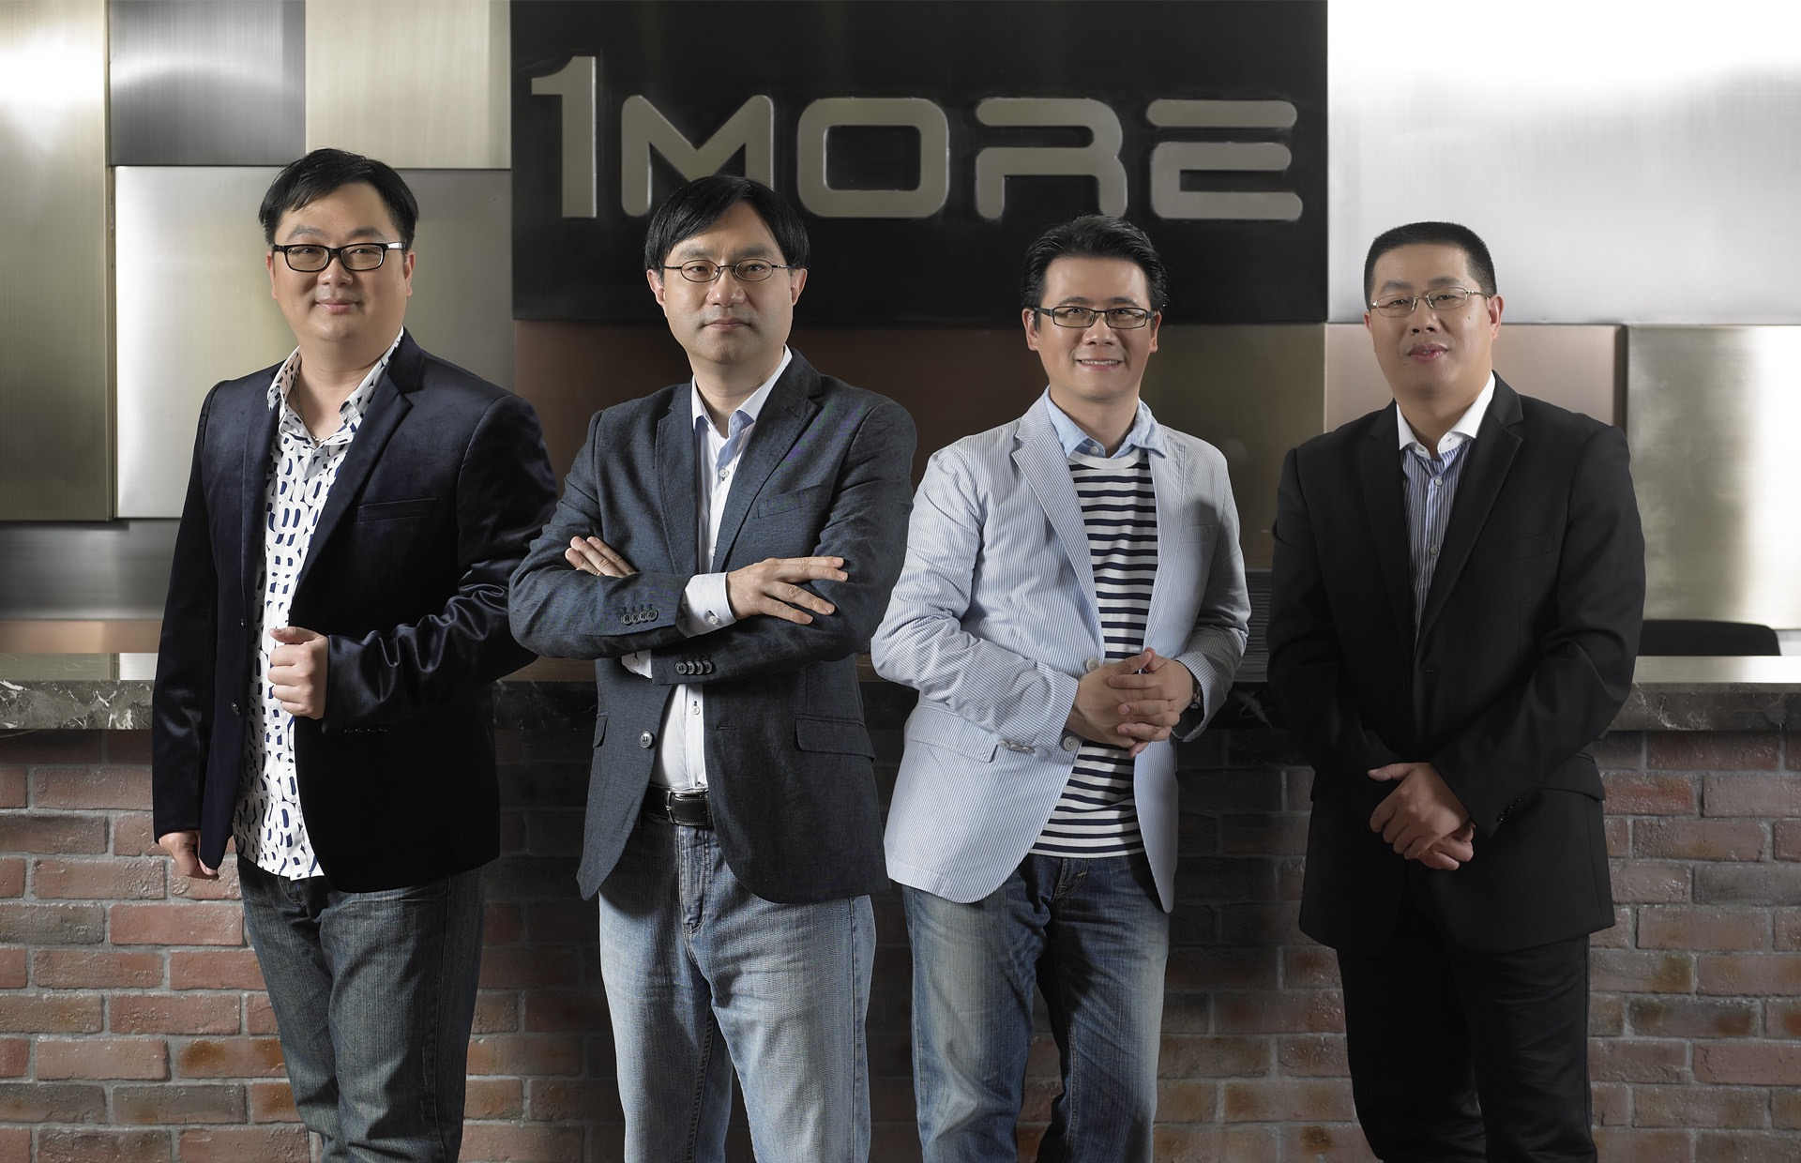
Team
Co-founder and VP of 1MORE
Founder and CEO of 1MORE
Co-founder and VP of 1MORE
Co-founder and VP of 1MORE
Howard Yu
Gary Hsieh
Frank Lin
Channing Zhang
Responsible for supply chain management , product development and design, and marketing;
More than 20 years of experience in sales and customer development in e-commerce;
Worked for in Mart, Mitac Technology, and Foxconn;
Co-founded MAG.Inc , an international brand of color displays;
Served at Foxconn for 10 years and was prized as the youngest BU to head groups that manufactured iPods, Kindle e-books , Foxconn’s picture frame division, and created the world's first electronic frame.
Responsible for brand marketing, sales, and E-Commerce operation and management;
More than 20 years experience in hardware and software research and development in the consumer electronics industry;
Worked for Foxconn Group;
15 years experience in product design verification, quality assurance, customer service support, and plant operations; responsible for product design, validation, manufacturing and quality management for Apple, Sony, Philips, Amazon, Huawei, Lenovo, and other global brands;
Worked as general manager of domestic medium-sized enterprises, responsible for the company's production operations and quality management.

Slide 6
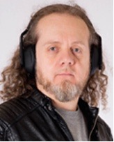
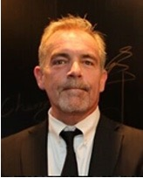
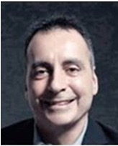
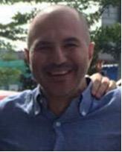
Team
Luca Bignardi (Italy)
Dave Russell (USA)
Luca Bignardi : world-class music producer and engineer
4 time Grammy Award winner
Luca has worked with these World-class artists：Andrea Bocelli、Luara Pausini、Vasco Rossi、Adriano Celentano、Ana Belen、Anastacia、Alexia、Gianni Morandi;
Works as 1MORE’s headphone tuner and sound designer.
Former BOD of Gateway.
Former Executive Vice President, Avalon Capital Group
Serves on the board of privately held Amazing Mail.com
Serves on the board of directors of Vizio, Inc., America’s fastest-growing HDTV and consumer electronics company.
Founder and Executive Chairman, Puro Sound Labs LLC
CEO of 1MORE USA
Mac Vincent (Canada)
Manouchehr Fathi (Denmark)
Former vice president of greater China for Sennheiser;
Member of 1MORE brand strategy brain trust.
Founder and Managing Partner, Ominor and CEO of Vers;
Held senior operations and engineering roles at companies including Amdahl, Supermac, Visioneer, Remedy and Flextronics. Long term cooperation in Nordic industrial design;
Executive responsibility for $3B global projects and over 26 year experiences in ID and operation;
Member of 1MORE brand strategy brain trust.

Slide 7
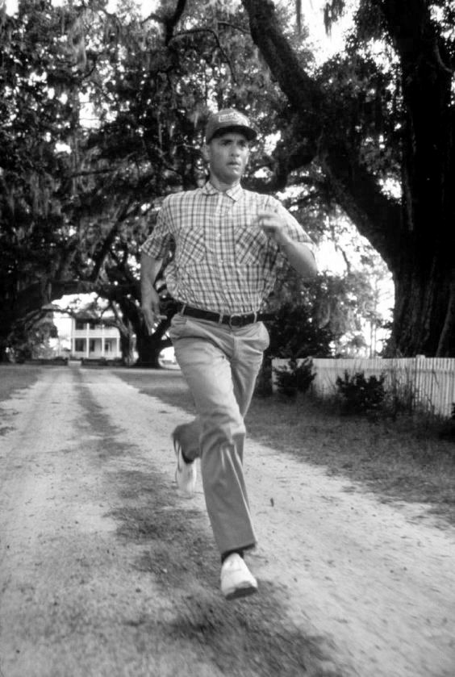
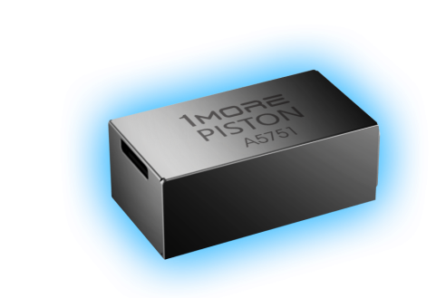
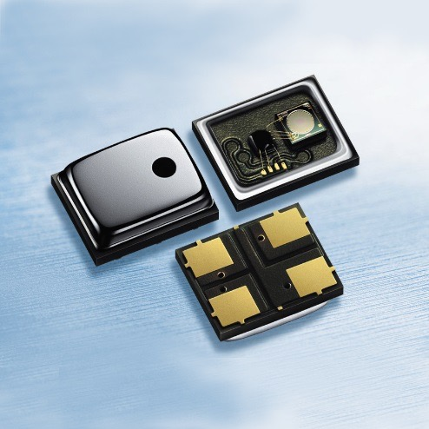
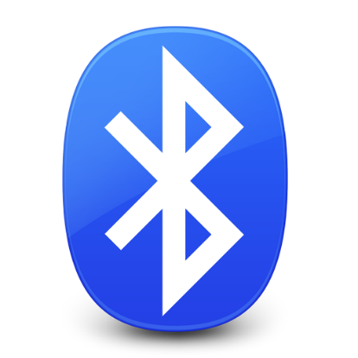
Alliance Partnership
Trade our key suppliers as strategic alliance partners.
Work together diligently with spirit of Forrest Gump.
Metallic Machine
Supplier
Balanced Armature
MEMS Microphone
BT Solution
ANC Solution

Slide 8
REVIEWS / MEDIA
“The entire experience is upscale, with no corners cut: fit, design, audio performance, packaging and accessories.” Brad Moon, Forbes
“These in-ears boast plenty of impressive features, but perhaps the most remarkable thing about them is the price: At $100, they make others in their class look embarrassingly overpriced” Ryan Waniata, Digital Trends
[1MORE is] already recognized for making some of the best audio products in the world. They’ve been winning both design and audiophile awards around the world,” Kevin Kelleher, Time Magazine
The Triple-Driver's sound is not only full and warm but nicely detailed. There's plenty of bass oomph and definition is decent enough. The midrange sounds clear and natural; this is a headphone that will appeal to audiophiles,” David Carnoy, CNET
“This in-ear headset performs well above its pay grade. 1MORE could easily ask for an extra $50”, Staff, TweakTown
“A terrific value product that will help reset the price performance bar for affordable portable audio.” Eric Neff, Headphone Guru

Slide 9
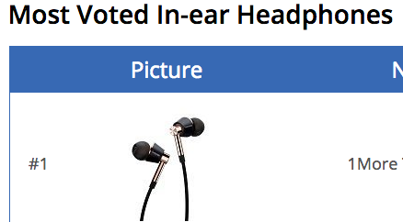
REVIEWS / MEDIA
“the 1More Triple Driver in-ear headphones did leave a great impression on me. I’ve used other headsets and earbuds that cost more and still don’t offer the audio quality on the triple driver,” Chris DelCastillo, Nerd Reactor
Beautiful presentation, clear and balanced, luxury at an affordable price, Maruice “MoeDawg,” Washington,” Head-Fi
At around $100, 1More has destroyed every other headphone set in or above their price range. I don’t see myself going back to wireless for a while. Brian Wharton, MacSources
“The 1MORE Triple Driver in-ear headphones can perform, when optimally fitted, on a level that wouldn’t be out of place in a $1,000 in-ear monitor,” Cliff Wade, Tech Dissected
“Its all the little things, like the immaculate packing, on top of great sound that makes the Triple Driver a must have,” Marshall Rosenthal, The Examiner

Slide 10
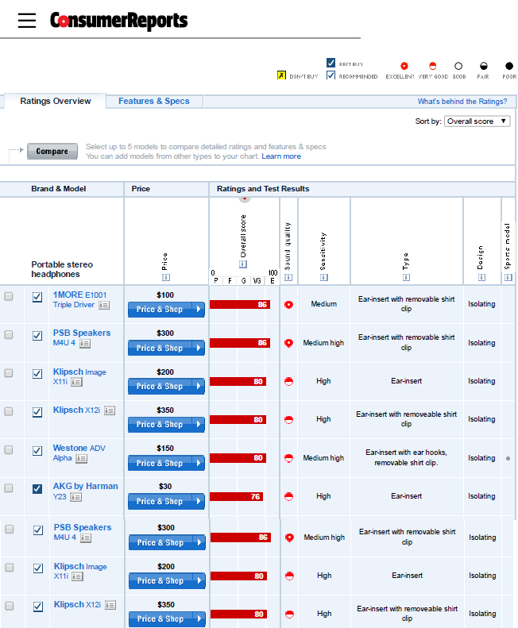
CR RANKING
#1
Rated Headphone
July 2016 Issue

Slide 11
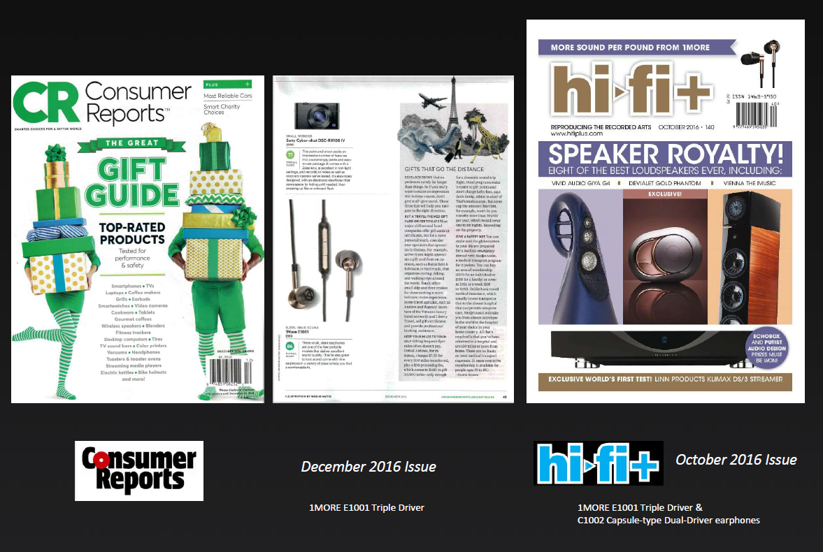

Slide 12
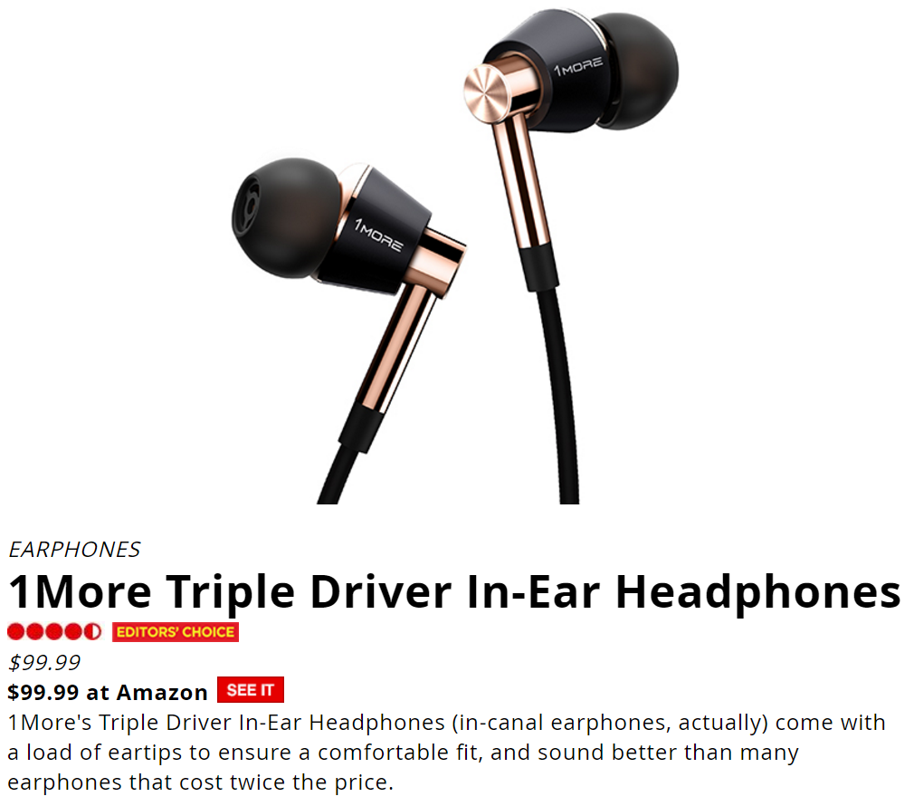

Slide 13
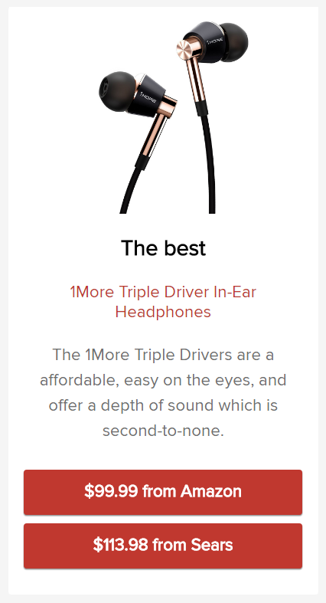

Slide 14
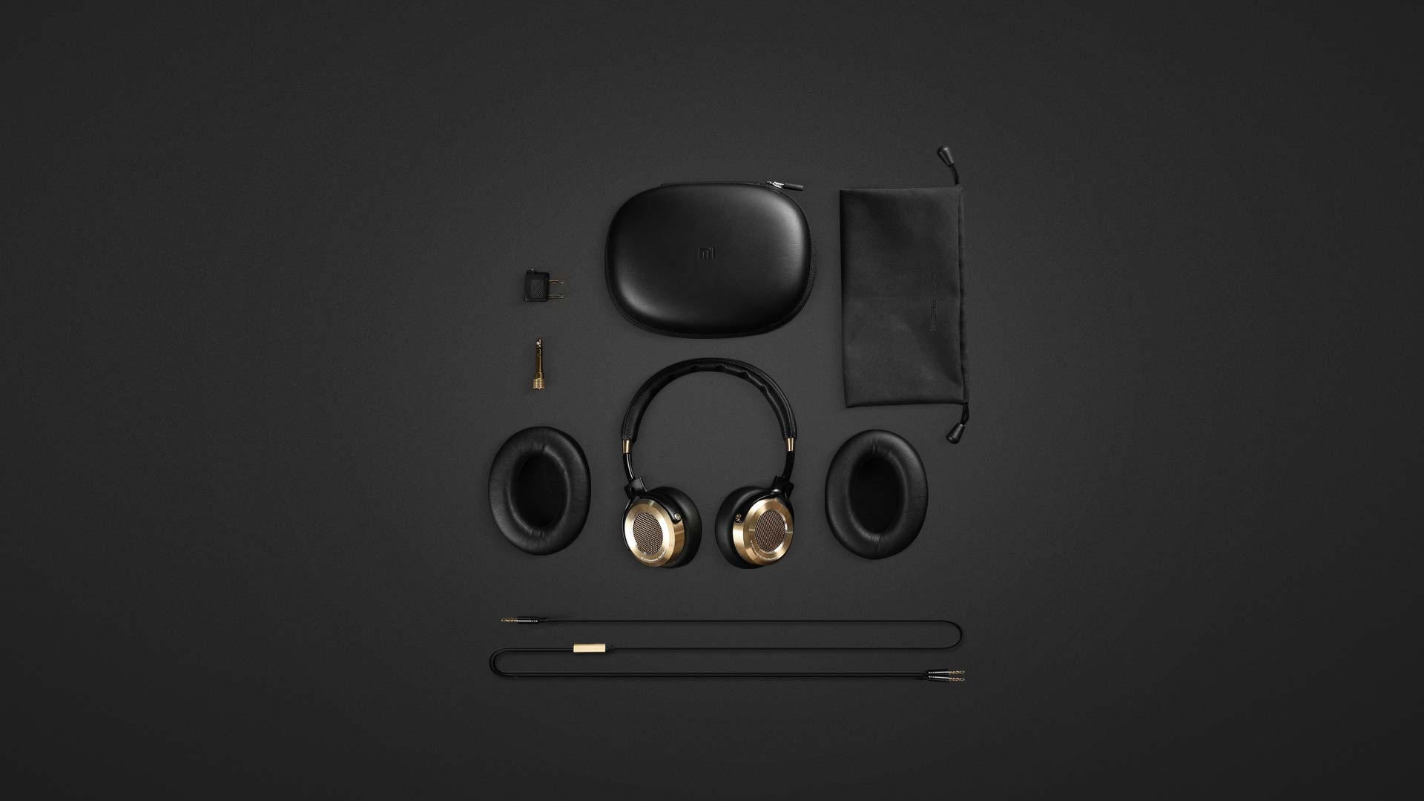
Technology and Products

Slide 15
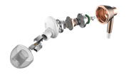
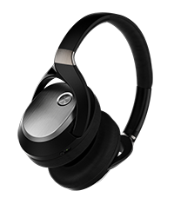
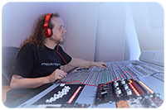
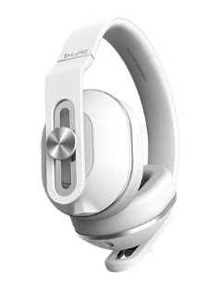
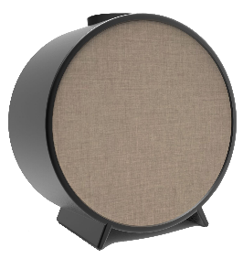
Technology and Products
Patented
Acoustic Technology
Metal Composite Diaphragm
Multi Drivers Headphones
Subjective Acoustic
ANC Headphones
Fashionable Smart Devices
Headphones +tracking
Fashionable audio devices
Smart Hearing Protection
Dual System Compatible
IOT Eco System
IOT Headphones
IOT Speaker
IOT Toys
Music Social Media

Slide 16
Piston Acoustic Technology
Patented Composite Layers of Diaphragm
Patented triple layer diaphragm design allows the listener to hear music as the artist originally intended.
The result is clear treble, immaculate midrange, and powerful bass.
Aero-space metal composite diaphragm (Explosion Fig.)

Slide 17
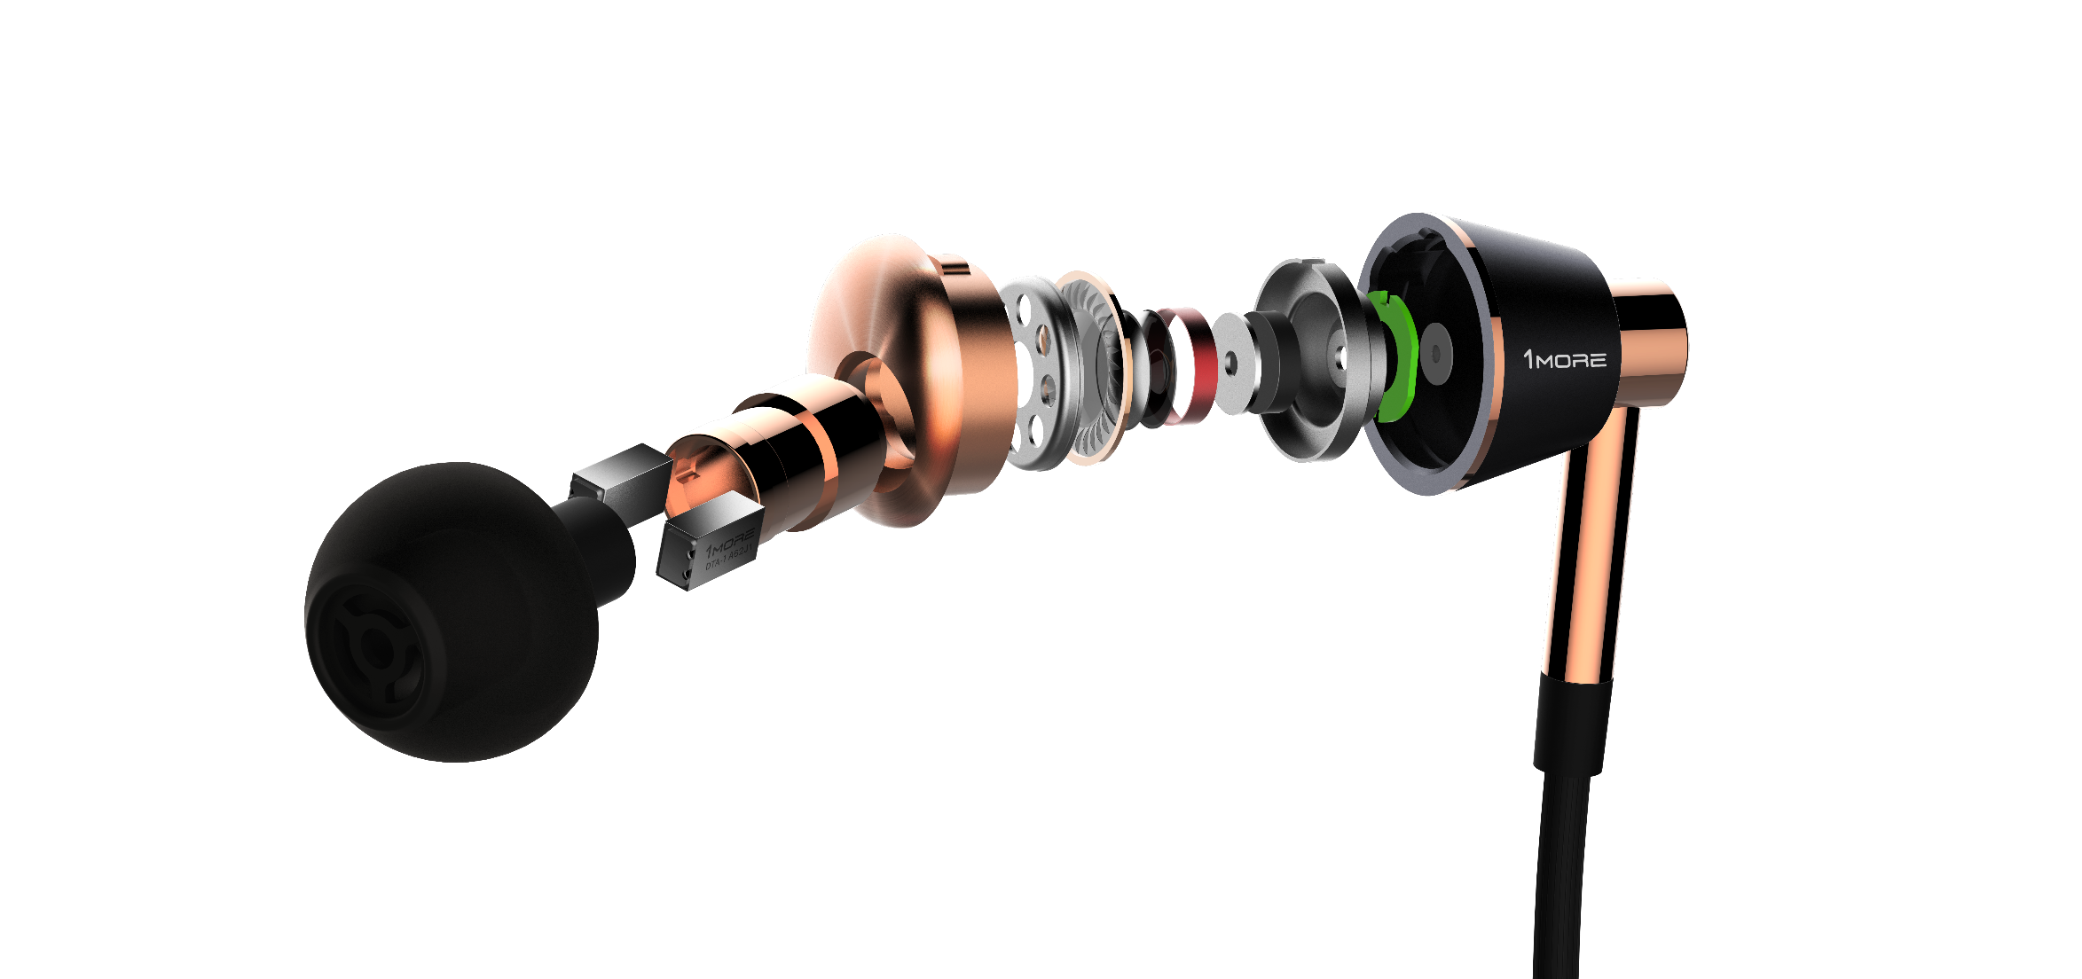
Meticulous Sound Applied with Triple Drivers
Two balanced armatures and a separate dynamic driver deliver an extremely powerful yet intimate listening experience. Together they create a spacious and transparent feeling of having nothing between you and your music. Our patented armatures work together to deliver sizzling highs and can withstand extremely high input power without distortion. They have an extended frequency range up to 40,000 Hz to reproduce high-resolution audio. Frequencies in this range add “transients”, a sonic quality normally only heard in live music. The armatures are uniquely inset with durable silicone covers for lasting performance and resilience. Our patented triple layer driver with aerospace grade metal inside two outer layers of PET, a resilient polymer, greatly increases bass and midrange response time, definition, and fullness.
Aerospace-grade metal composite diaphragm
dynamic driver
Patent balanced armature driver

Slide 18
Dual-system intelligent controls
Compatible with iOS and Android
Dual-system intelligent controls are compatible with both Apple iOS and Android systems, allowing the user to change volume, play/pause, and take calls.

Slide 19
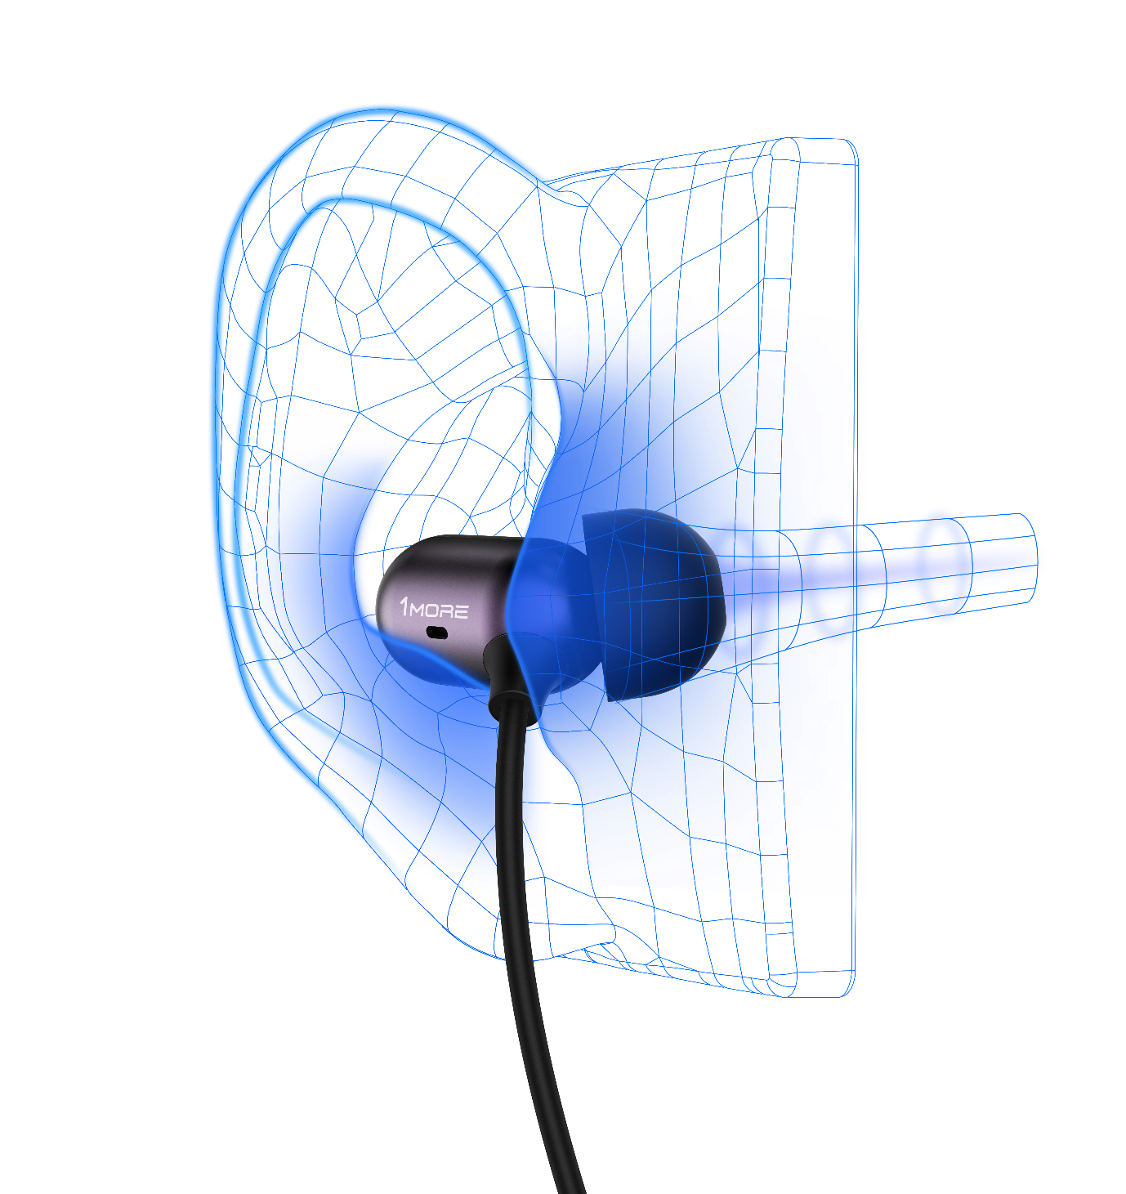
Precise Ergonomic Design
According to the medical canal data of various age sections and different genders,
we designed an average size of ear buds with a more comfortable way to fit in.

Slide 20
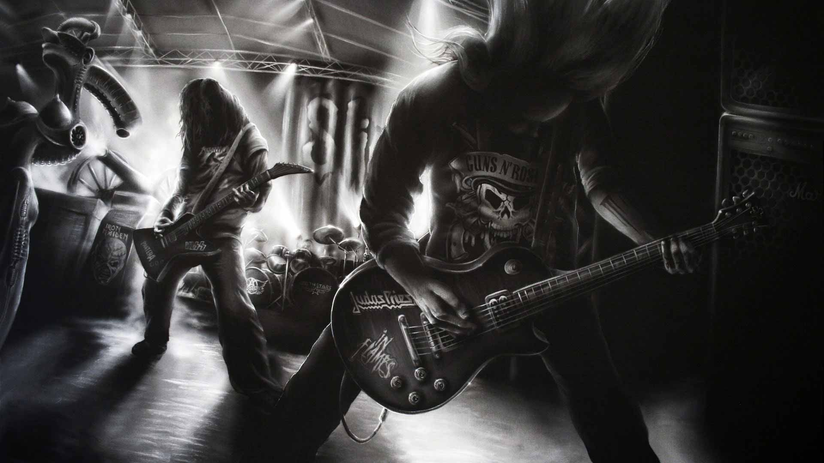
Brand Personality
Adventurer
with
Passion
Notes:
外表冷酷一页：北欧的极简风格设计；南欧的音质风格；

Slide 21
Brand Personality
Pop-Pro:
Popular Profession

Slide 22
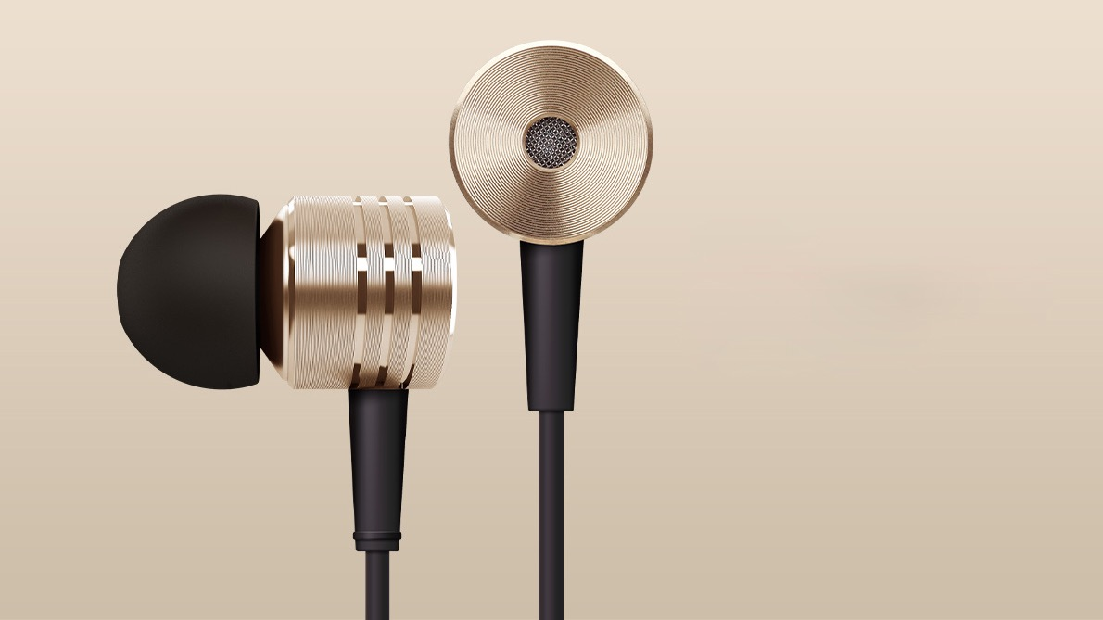
Nordic Design Style
Precision Metal Craftmanship

Slide 23
Luca Bignardi
Four Time Grammy Award Winner
Italian Brand Ambassador with a deep passion for perfecting 1MORE’s sound

Slide 24
Honor List
2014 iF Award
2014 Reddot Award
2015 China Good Design
2016 iF Award
2014 Computex Award

Slide 25
Honor List
2016 iF Award
2015 iF Award
2015 Reddot
Honorable Mentioned
2016 iF Award
2016 iF Award

Slide 26
Media Review
“Rich sound and luxury feel.”
“You never feel like these buds are going to blow you out of the water down low.”
“I was rewarded with a level of dynamic slam, especially in the mid and low bass, that rivaled any in-ear I’ve used.”
“I was amazed at the quality and range of sound that these produced, from treble to bass. “

Slide 27
Recommendations
Former CEO of Sennheiser Asia - Marc Vincent
“For ears, eyes and hands, 1MORE product full with sense of quality and taste."
Famous American Producer & Sound Engineer - David Kellogg
“1More is offering something unprecedented- supremely accurate and professionally balanced earphones that are elegantly designed and incredibly affordable.”
American Senior Reviewer - Ian Scott-Parker
“Nothing seemed to be outside the capabilities of these earphones.”

Slide 28
Current Facts
Quality and Reliability
99%
0.03%（300 DPPM）
The product yield is above , RMA ratio is less than
Total tests on products' functional reliability and user's experiences amount to items.
Environmental tests on toxic substances and elements amount to items.
732
175
Sales and Recommendations
3
20,000,000
Total sales in less than years amount to pcs.
Day sale on Nov 11th, 2014 amounts to pcs, which is in headphones of mainland China.
Online recommendations amount to and five-star rank above by May 10th, 2016.
200,000
No.1
2,560,000
99%
International Awards
10
3
Won international design awards in years.
Business Expansions
18
20
150
provincial distributions, T-Mall online shops and offline experiencing stores in mainland of China.
Sales in countries and regions as following: USA, England, Japan, Korea and Taiwan China.
5

Slide 29
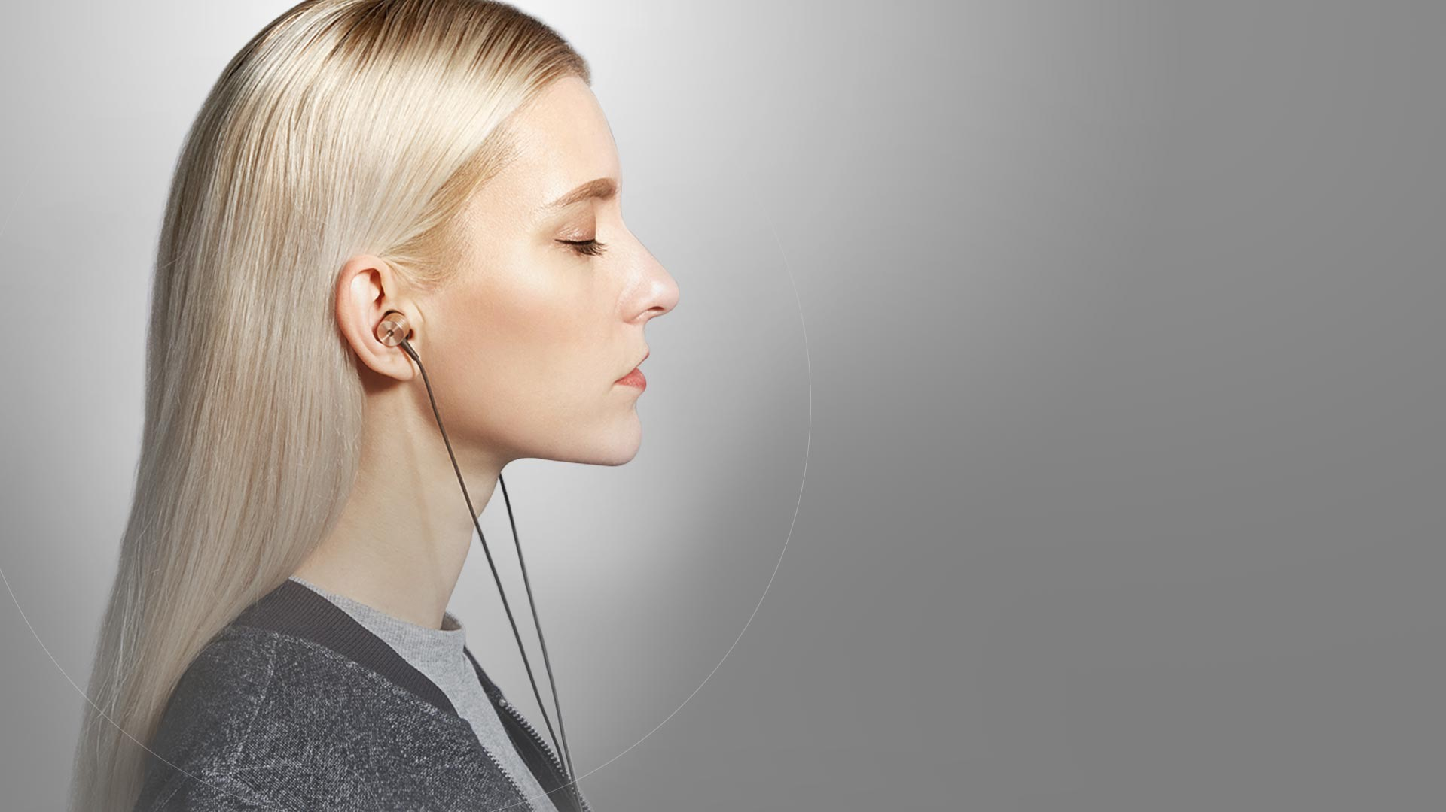
1 MORE Piston Classic （In- Ear）
Metal Composite Diaphragm
A better taste with surging
and melodious sound
Millions of people like the classic style. It’s the very style we need to extend. we’ve selected metal composite diaphragm, to allow the metal clip to have outstanding performance in high frequency, give you a mellow sound in detail. PET materials are flexible and soft, which provide a mellow mid-sound as well as strong bass. Tie in optimized program, make you feel more comfortable, balance and shock. Will not get bored though listen for a period of time.

Slide 30
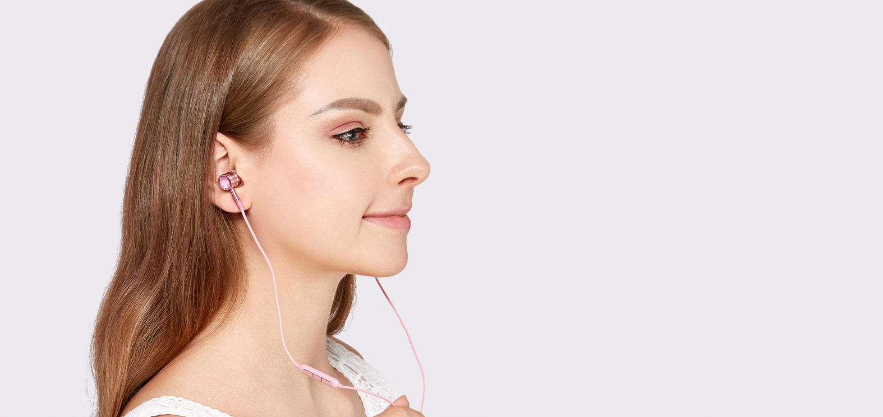
1MORE Crystal
Piston Earphones
· Swarovski ® elements
· Luxury quality
· Vivi listening experience
· Dual-system intelligent control

Slide 31
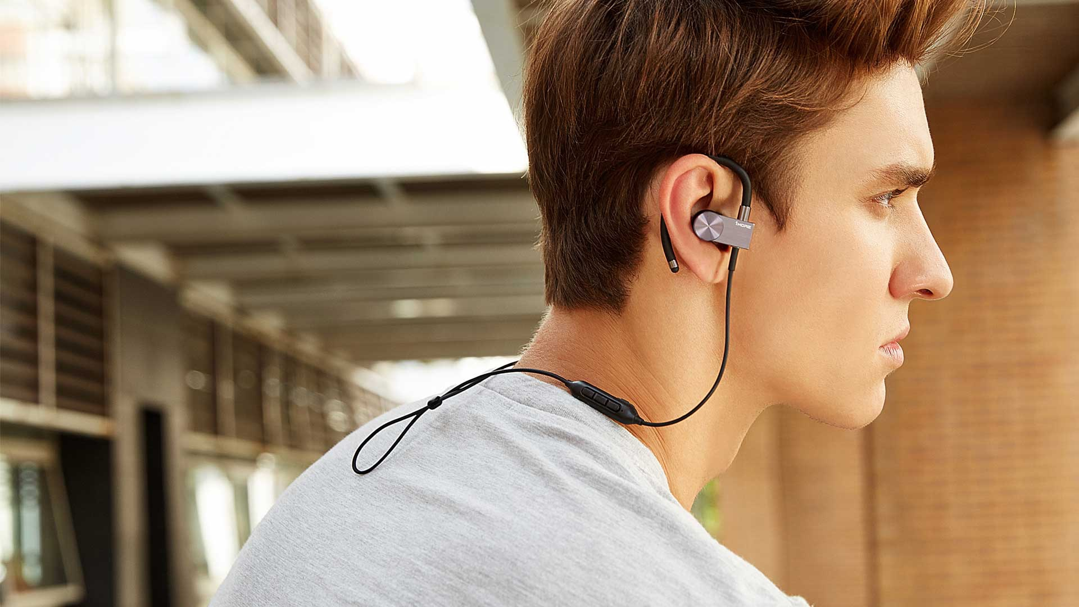
1 MORE Active Bluetooth In-Ear Headphones
Nordic minimalist design
Light-luxury fashion
Metal surfaces of the headphones uses more than 20 sophisticated metal processing: CNC precision carving “disc-like pattern”, preventing fingerprints and scratches. High light brushed metal surface and edges using a blasting process. The headphone hooks made with advanced engineering plastic molding and a metal decorative embellishment is decorated on it.
Metal surface using Anodic oxidation processing, to ensure that color always like new--ruby red and the titanium black in your life!

Slide 32
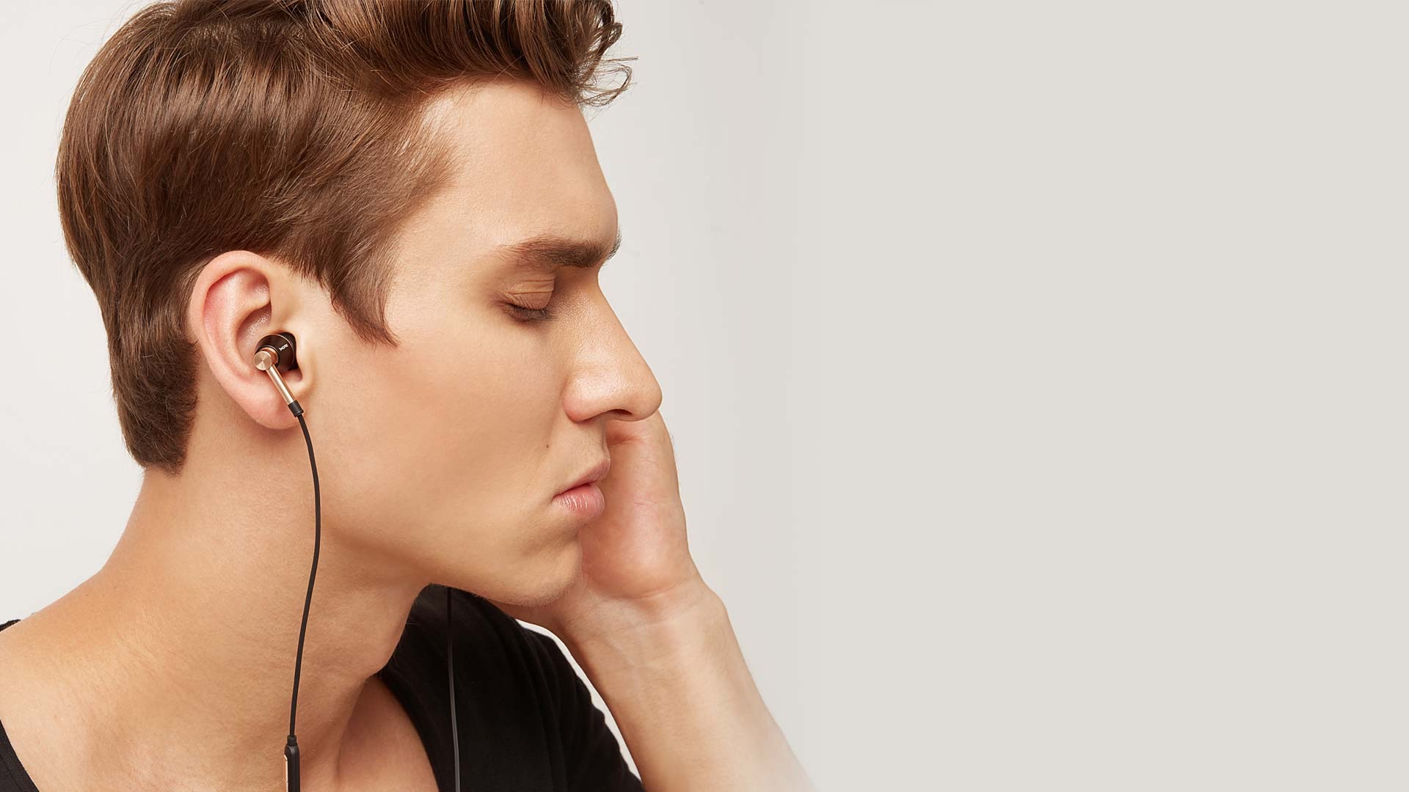
1 MORE Triple-Driver In-Ear Headphones
COMFORTABLE ERGONOMIC DESIGN
Our In-Ear Triple Driver’s have oblique angles that naturally match your ear canals. They come with seven sets of silicon ear tips and three sets of memory foam ear tips ensuring a perfect fit. Besides fit, the silicon enhances lower frequencies while the foam enhances higher frequencies to satisfy your sonic preferences. The snug fit increases noise isolation and bass, eliminating the need for unnatural and unhealthy boosting.

Slide 33
1MORE Over Ear Headphones
Low Profile Black
Hale quality,
comfortable experience

Slide 34
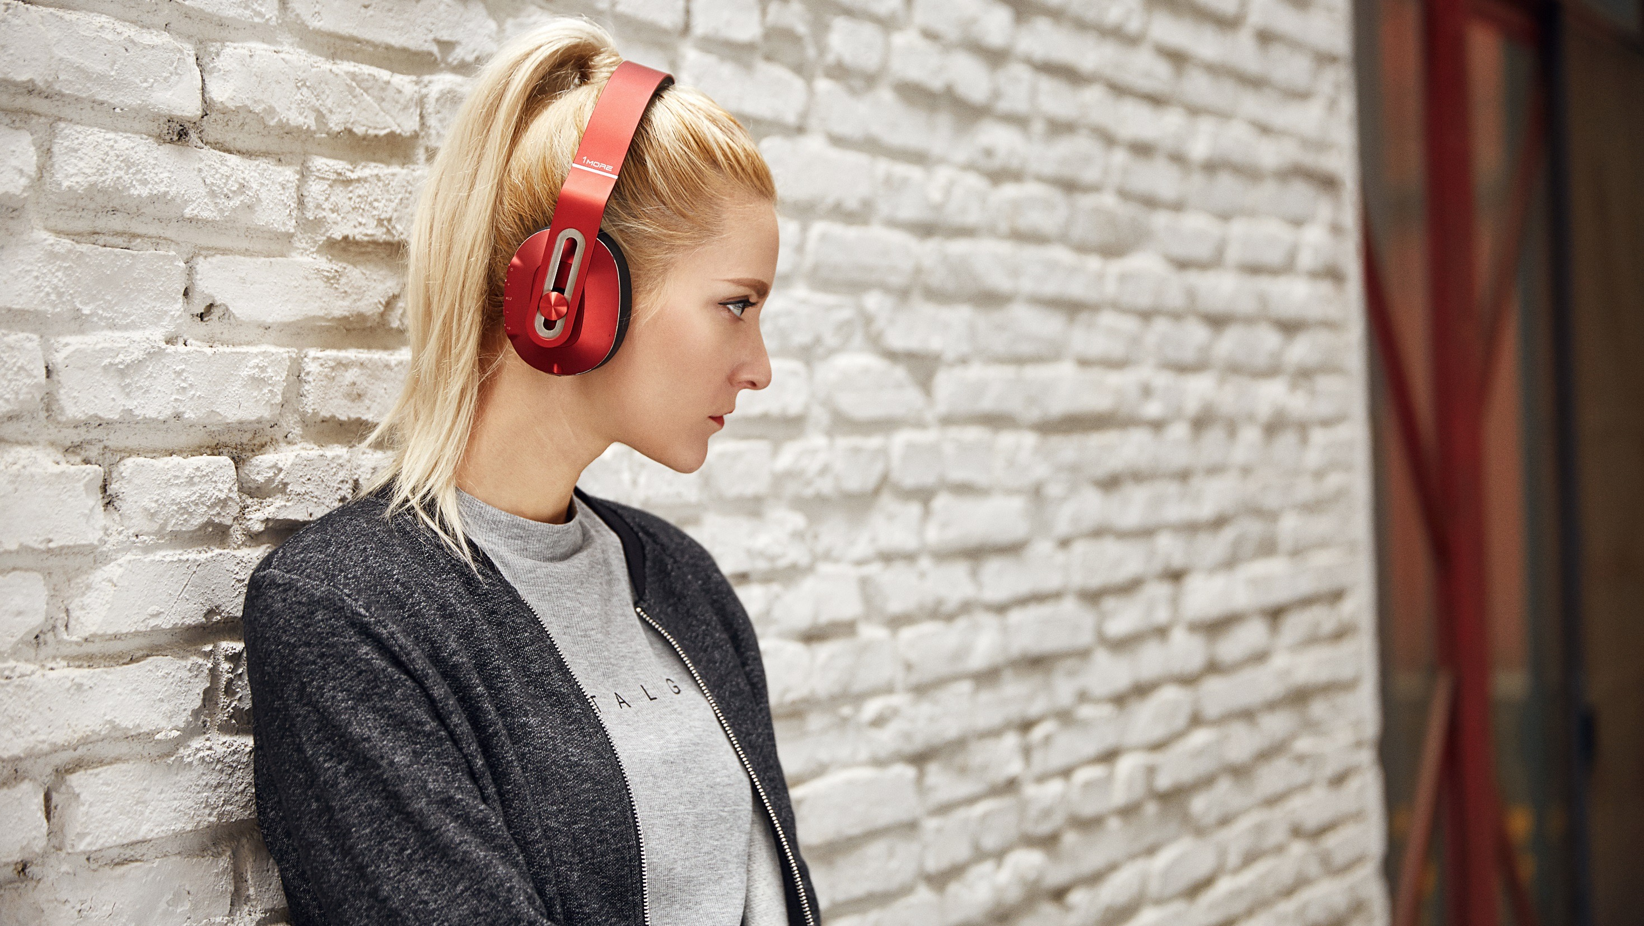
1 MORE Bluetooth Over-Ear Headphones
HIGH QUALITY SOUND IS MEANINGLESS WITHOUT A COMFORTABLE FIT
The ear cups of these headphones rotate in four directions, so that you can customize them to the perfect position for your ears.
The solid headband is manufactured with shape memory TR-90 titanium steel. Incorporating this material in the ergonomic design allows for the stretching required with everyday use. TR-90 steel is flexible, lightweight and sweat resistant.

Slide 35
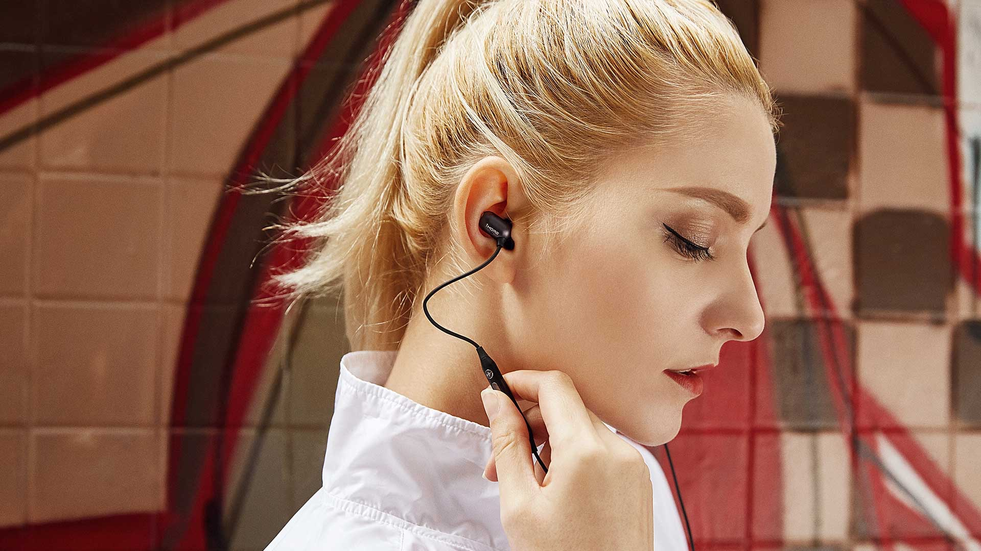
1MORE Capsule In-ear headphones
Let the earbuds lie in your ear
A new way of wearing in-ear headphones. Ultra-Compact yet comfortable earbuds with ergonomic design
The earbuds are hidden inside the ears, which makes the headphones more comfortable to wear and less possible to fall out. What’s more, the earbuds includes silicone covers, which ensure earbuds stay in during activities.

Slide 36
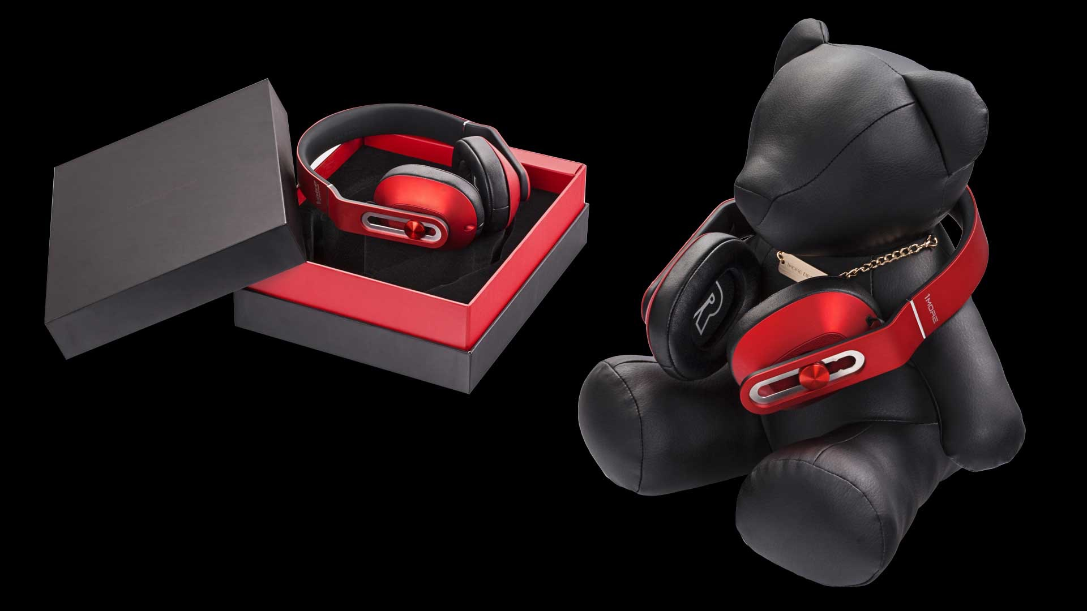
1 MORE Bluetooth Over-Ear Headphones
Premium packing
Only for showing, not included in Headphones selling

Slide 37
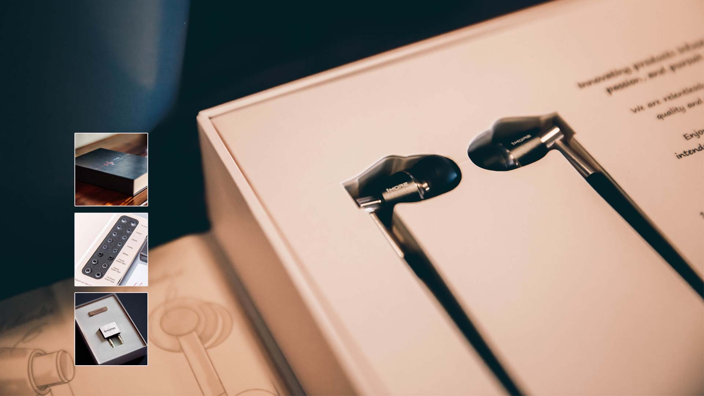
1 MORE Triple-Driver In-Ear Headphones
Retro packing
8 pairs of ear plugs
Aviation plug 、Metal clips

Slide 38
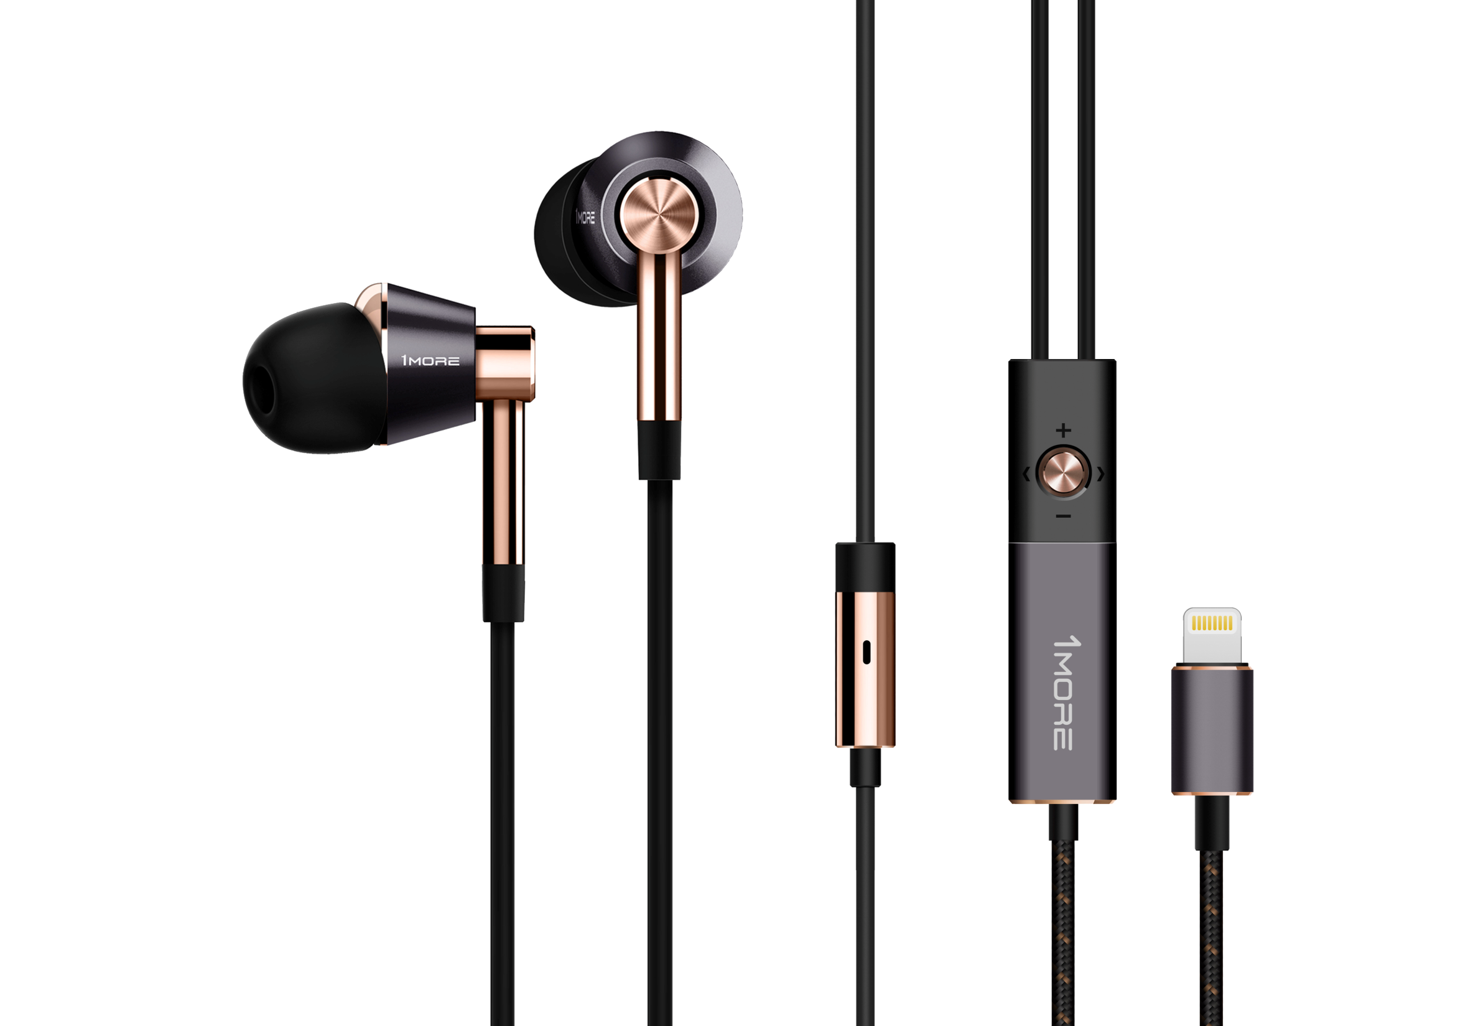
Triple Driver Lightning In-Ear Headphones
This Triple Driver Earphones with Aluminum finishing provides luxurious metallic feel
Patented iron-ring structure, more balanced with tri band
Enthusiast wire design, fashionable

Slide 39
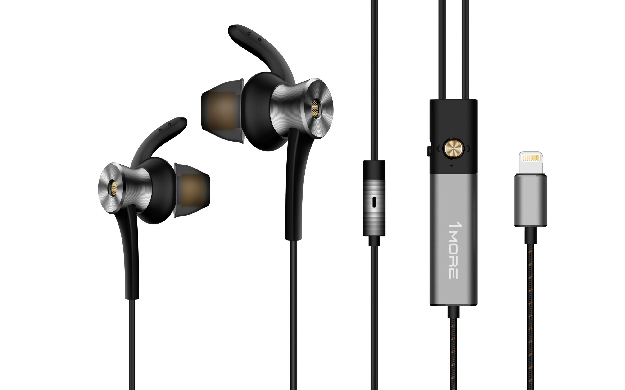
ANC Lightning In-Ear Headphones
Effectively isolating external noise for better listening experience
Ergonomic design, comfortable fitting
Patented iron-ring speaker design, high definition
listening experience

Slide 40
Global Media Recommendations

Slide 41
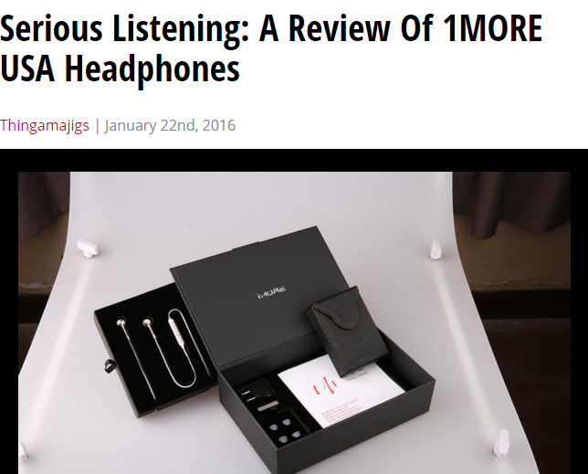
Elmoremagazine
“I was amazed at the quality and range of sound that these produced, from treble to bass. The sound transitions between different genres of music and then to a podcast or audiobook without a reduction of clarity.”
——Elmoremagazine
http://www.elmoremagazine.com/2016/01/thingamajigs/serious-listening-a-review-of-1more-usa-headphones

Slide 42
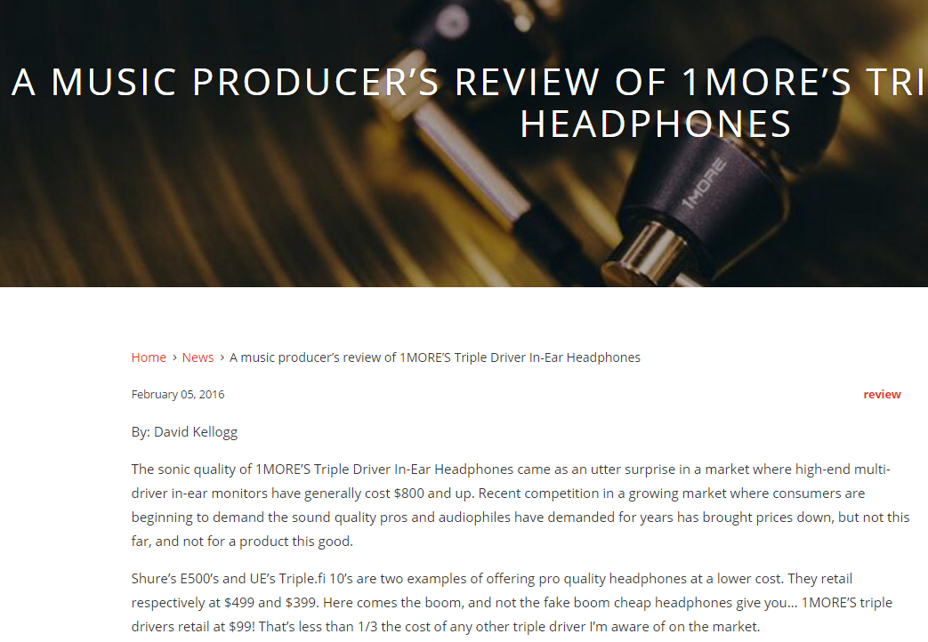
David Kellogg
“1More is offering something unprecedented- supremely accurate and professionally balanced earphones that are elegantly designed and incredibly affordable.”
——David Kellogg
http://usa.1more.com/blogs/news/114192647-a-music-producer-s-review-of-1more-s-triple-driver-in-ear-headphones
David Kellogg has been a career sound engineer and music producer for 25 years. At various studios including his own, Droptone, he has worked with producers such as Butch Vig (Garbage, Nirvana) and artists such as Lenny Kravitz, Jimmy Cliff, Talib Kweli, and Beres Hammond.

Slide 43
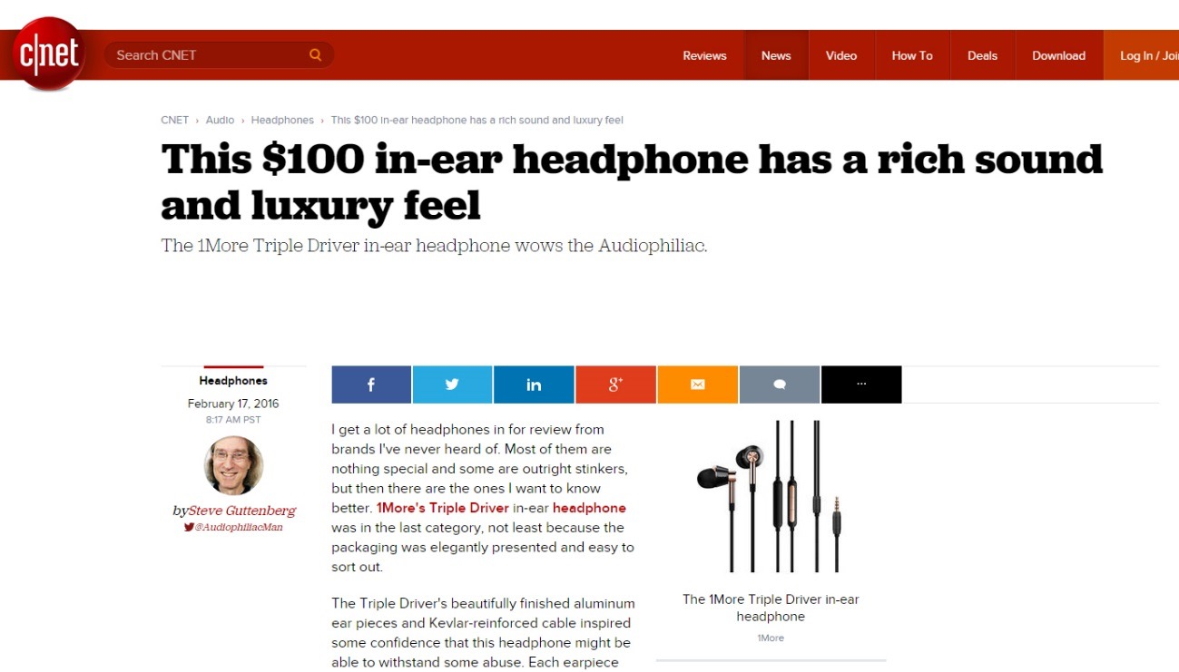
CNET
“It was akin to listening to headphones plugged into a tube amplifier, everything was just a little prettier and nicer sounding with the Triple Driver.”
——Steve Guttenberg
http://www.cnet.com/news/this-100-in-ear-headphone-has-a-rich-sound-and-luxury-feel/

Slide 44
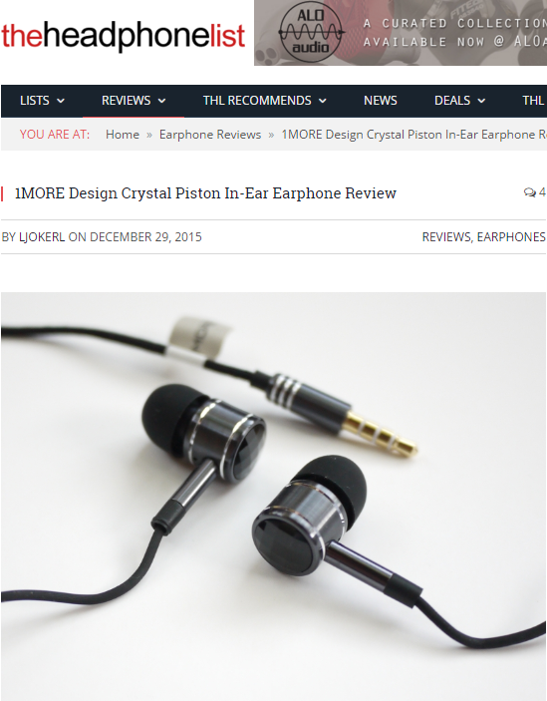
Theheadphonelist
“The only truly high-performance fashion in-ear I’ve tried.”
——Theheadphonelist
http://theheadphonelist.com/headphone_review/1more-design-crystal-piston-in-ear-earphone-review/

Slide 45
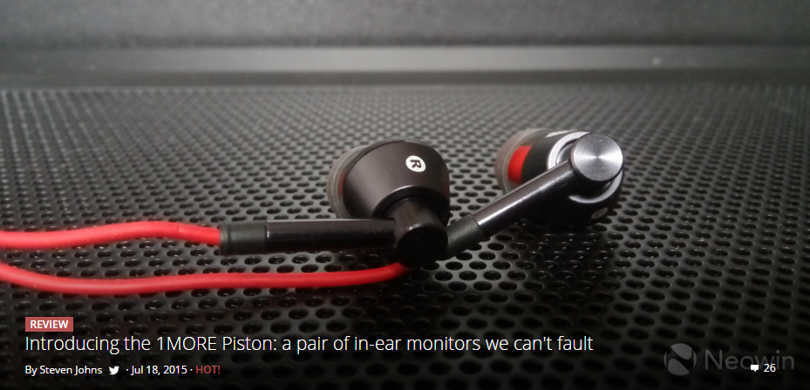
Neowin
“The lows, mids and highs were all well balanced... Songs with heavy bass didn't disappoint, and female vocal was still extremely enjoyable. ”
——Neowin
http://www.neowin.net/news/introducing-the-1more-piston-a-pair-of-in-ear-monitors-we-cant-fault

Slide 46
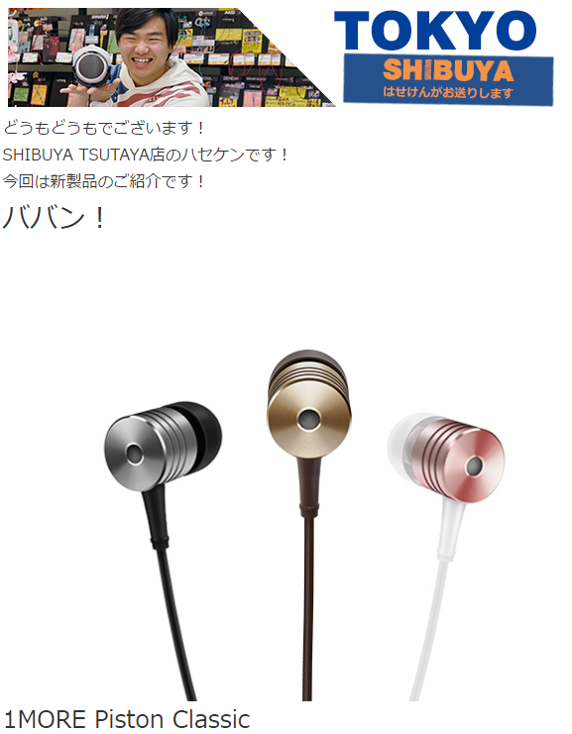
E-earphone (Japan)
“【本日解禁！】那个高性价比的耳机回归啦！”
—— E-earphone
http://www.e-earphone.jp/blog/?p=44408

Slide 47
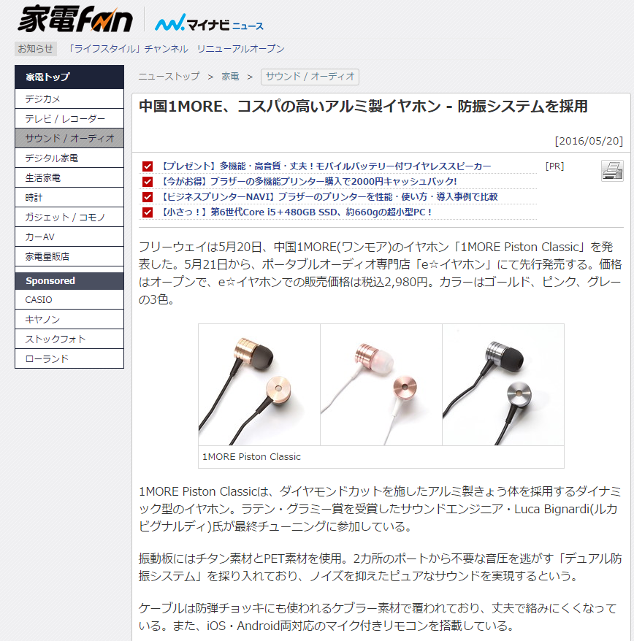
Mynavi News (Japan)
“中国1MORE、性价比非常高的铝製耳机 , 采用防振系统”
—— Mynavi News
http://news.mynavi.jp/news/2016/05/20/223/

Slide 48
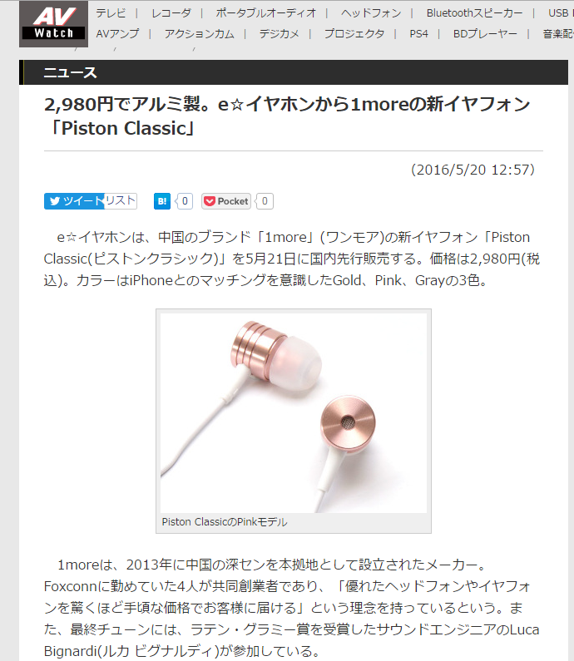
AV Watch (Japan)
“ 2,980円就能买到铝制耳机。e☆イヤホン发售1moreの新品「Piston Classic」 “
—— AV Watch
http://av.watch.impress.co.jp/docs/news/20160520_758338.html

Slide 49
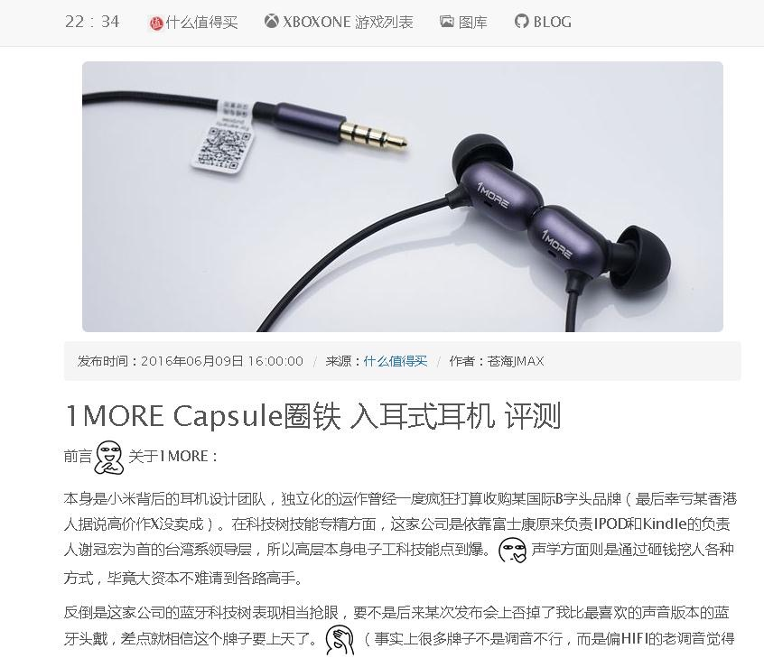
FNZOO (Taiwan)
“比较出彩的还是要数这货的线控相当精美，造型也做得相当漂亮，这超越了我以前看过不少国内品牌的线控设计。“
—— FNZOO
https://fnzoo.com/article/info/48597.html

Slide 50
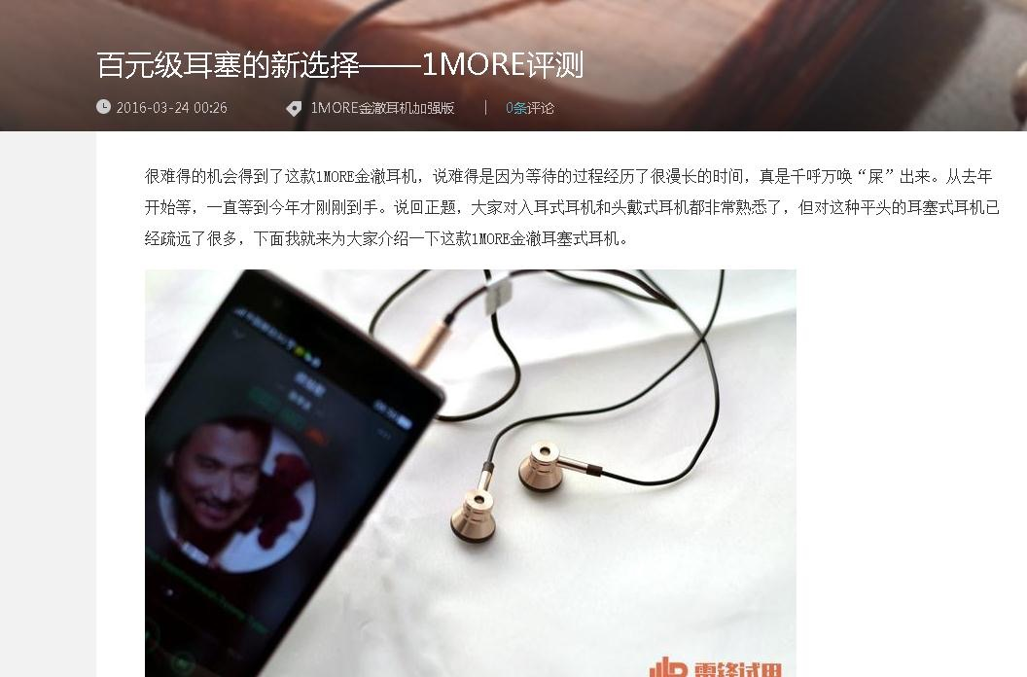
igao7 (Taiwan)
“这款百元级的耳机有超出了这个价格的发挥，虽然无法和高端耳机相比，但无论是高音、中音还是低音，与三百元左右的耳机都不相上下。“
—— igao7
http://www.igao7.com/news/201603/TTYWpJG3l90W9cmQ.html

Slide 51
In Ear Kopfhorer (Germany)
“Die Firma 1More, welche auch hinter der Entwicklung der sehr beliebten Xiaomi Piston 3 und Xiaomi Hybrid steckt, bringt mit dem 1More Triple Driver E1001 einen preislich erschwinglichen Hybrid In-Ear Kopfhörern mit 3 Schallwandlern heraus. “
—— In Ear Kopfhorer
http://www.inearkopfhoerer-tests.de/testberichte/1more-triple-driver-im-test/

